Slide 1
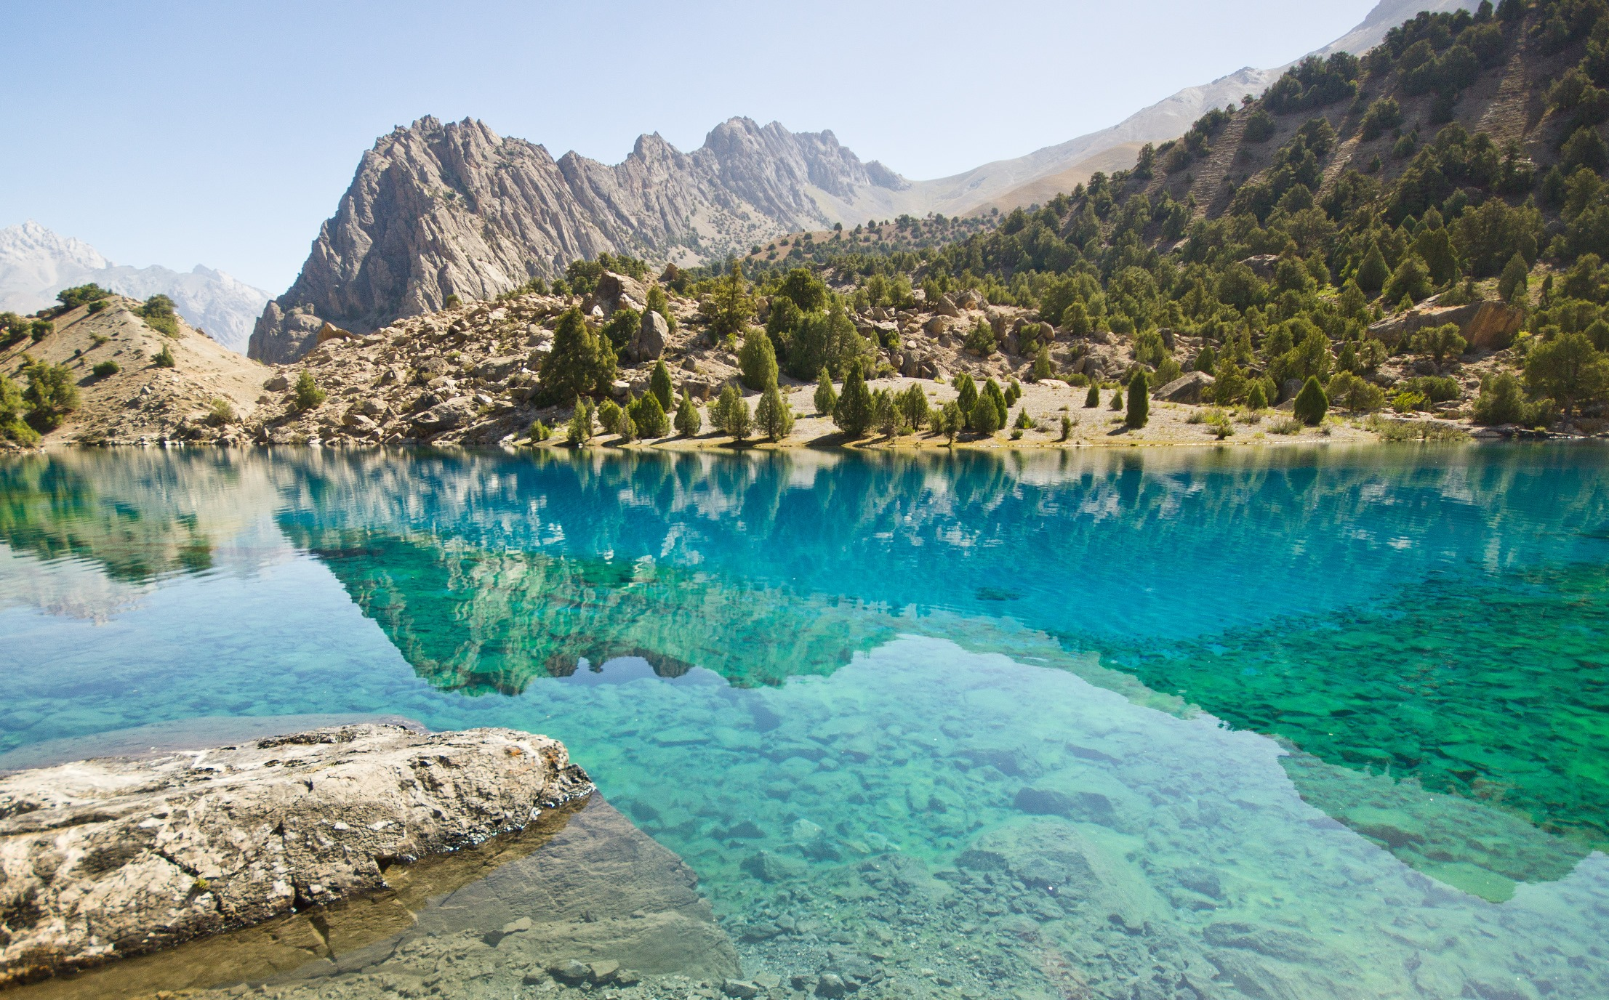

THE LAND OF GREEN ECONOMY
STATE COMMITTEE ON INVESTENT AND STATE PROPERTY MANAGEMENT
INVEST IN
TAJIKISTAN

Slide 2
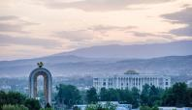

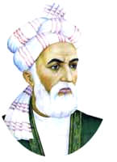
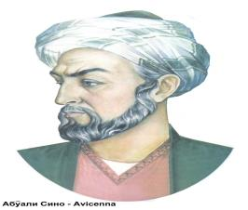
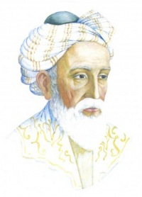







GENERAL INFORAMTION
WE ARE OFFSPRING
RUDAKI
FIRDOUSI
AVICENNA
KHAYAM
Location: CENTRAL ASIA
Area: 141 400 кm²
Population: 9,1 MILLION
2007
REPUBLIC OF TAJIKISTAN
Capital: DUSHANBE
Average age: 23 YEARS
Arrival: by PLANE, TRAIN,
BUS & CAR
Currency (code): SOMONI (TJ)
Administrative centers: DUSHANBE, KHUJAND, BOKHTAR,
KULOB, KHOROG
THE LAND OF GREEN ECONOMY

Slide 3








STRATEGIC VISION
Source of funding: from the private sector 54.7 billion US dollars (46.3%)
GOALS
TRAJECTORIES OF DEVELOPMENT
Energy security and efficient use of electricity
Annual economic growth: 8-9%
Breaking the communication deadlock and turning Tajikistan into a transit country
3 or more times GDP increase
Ensuring food security and public access to good nutrition
Diversification of the national economy
Expanding productive employment and rapid industrialization
Poverty reduction of more than 2 times and
increasing the share of the middle class to 50%;

Slide 4
MAIN INDICATORS
ANNUAL GDP GROWTH
INFLATION
7%
6,3%
5,4%
FOREIGN TRADE TURNOVER
UNEMPLOYMENT

Slide 5


ADVANTAGES OF TAJIKISTAN
TAJIKISTAN – RELIABLE PARTNER
Openness, transparency and security
Liberal trading regimes and a wide range of fiscal benefits
Harmonized legislation and high investor protection
Easy Visa Access
Political Stability and Economic Potential
Motivated Workforce, Educated Talent Pool

Slide 6

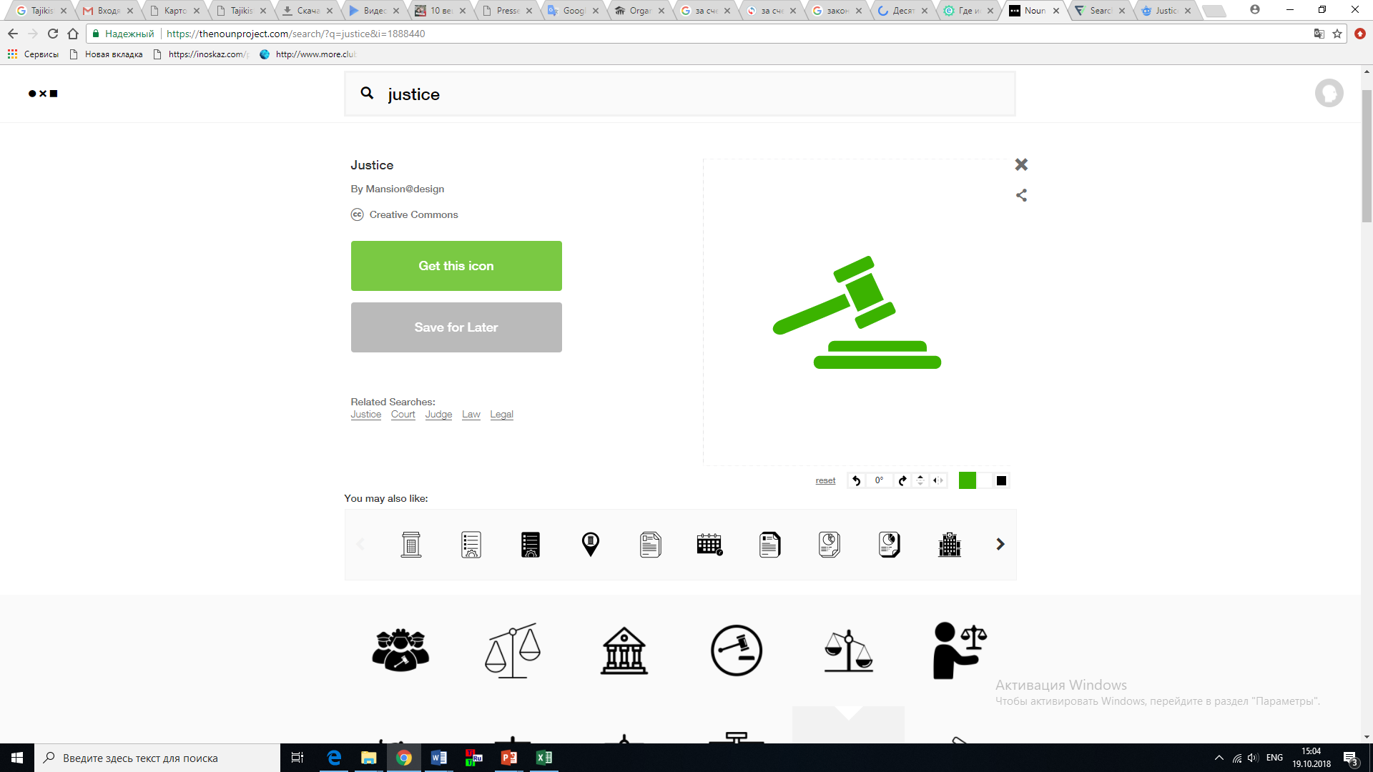
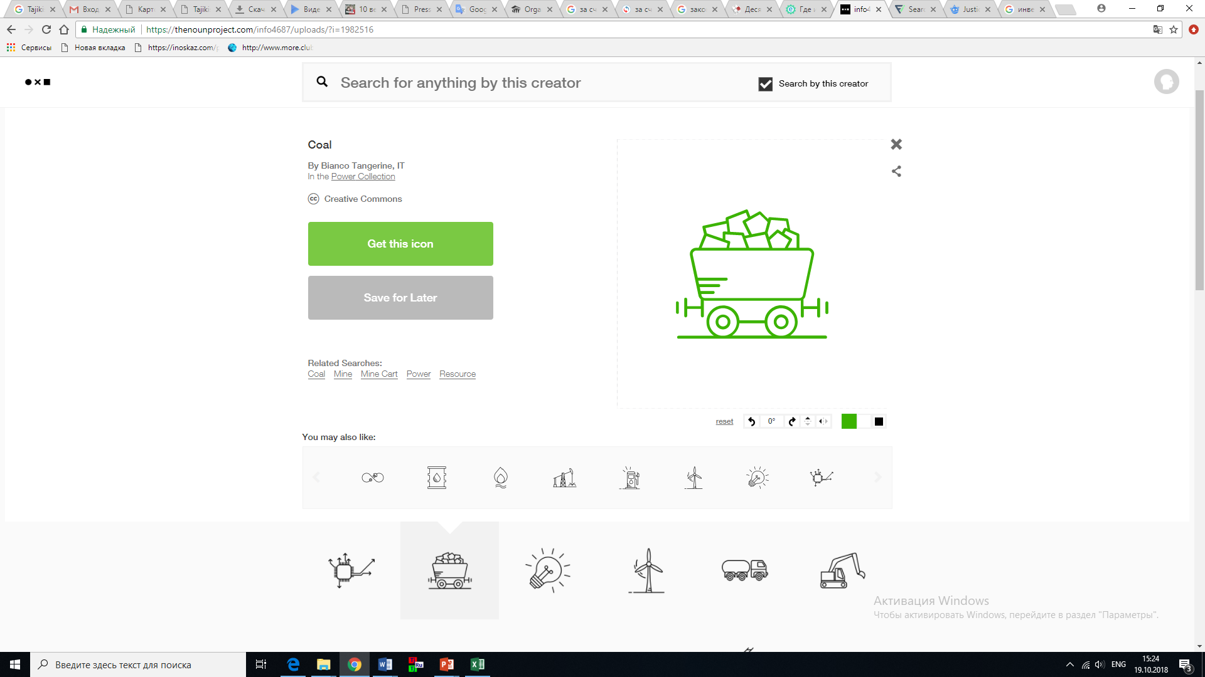
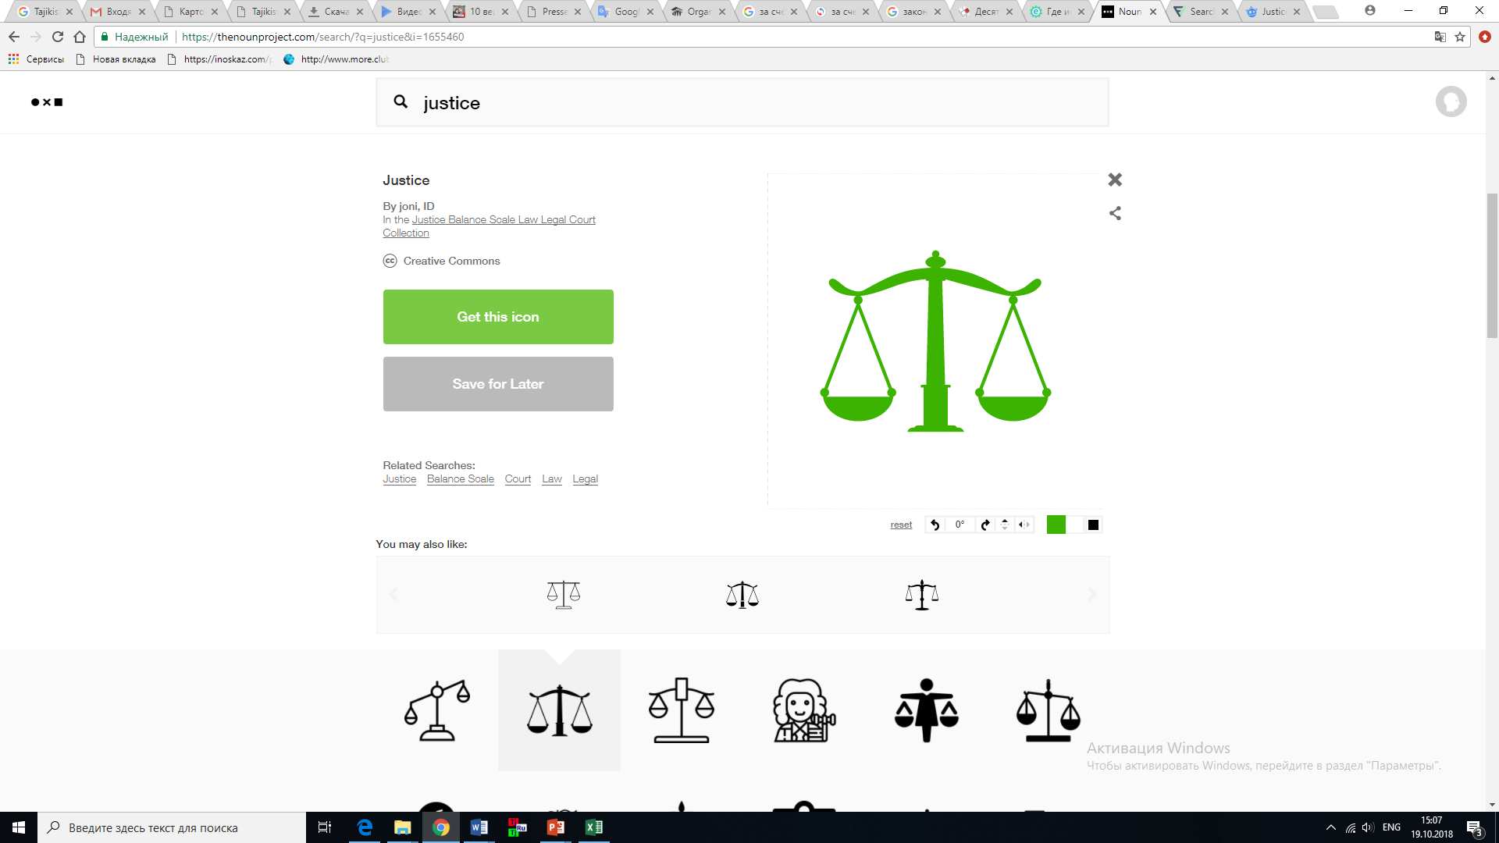
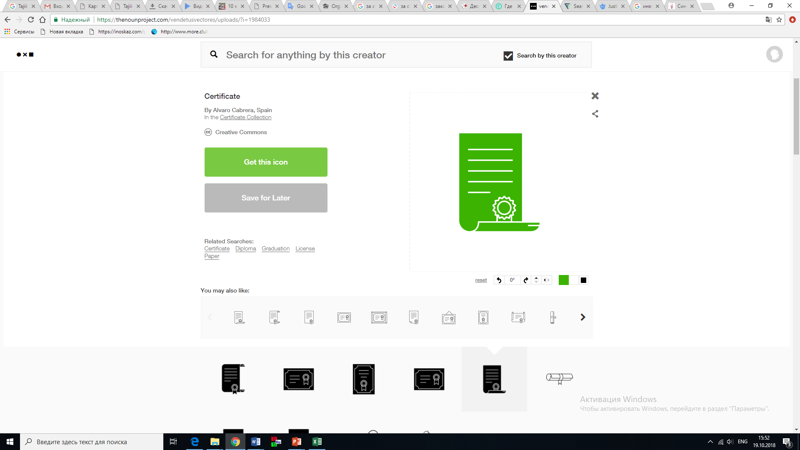
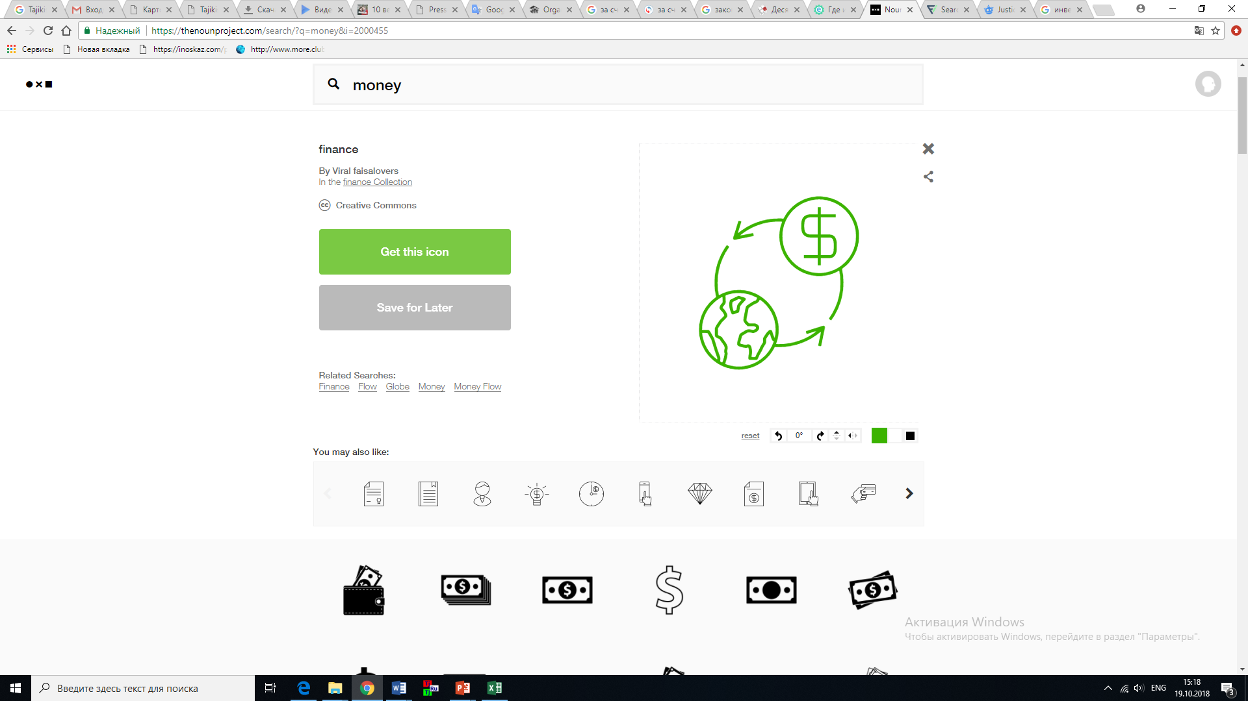
LEGAL STATUS AND REGULATION ON FDI
Stabilization Clause
Guaranties against changes of legislation on investments for 10 years
No Restrictions
Unrestricted access to all resources, sectors and geographic locations within the country
IPR Protection
Free movement of property and information
Protection of intellectual property rights
Equal Treatment
Equal rights of domestic and foreign investors
No restrictions on the repatriation of profits and remittances
Free exchange of foreign currencies

Slide 7
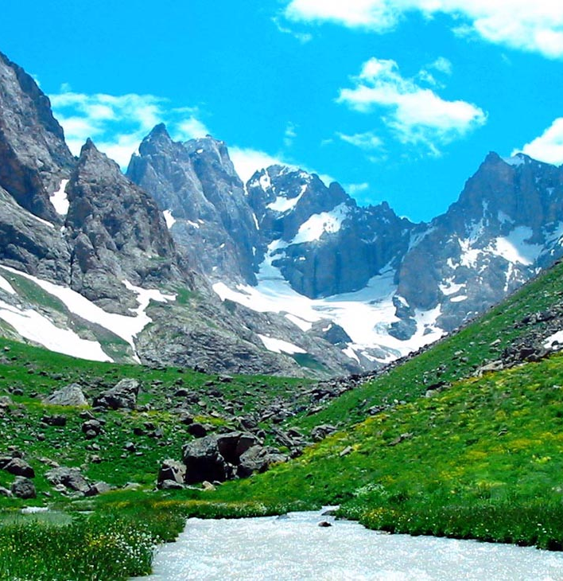
INVESTMENT COOPERATIONT THROUGH
1
Investment Agreements
2
Public Private Partnership
3
Concession Agreement
4
Production Sharing Agreement

Slide 8
Preferences for Investors
Tax Profit Exemption
Agriculture
Industry
- The importation of agricultural machinery
is exempted from the payment of value
added tax and custom duties.
- Poultry farms and enterprises producing
feed for poultry and cattle are exempted
from profit tax, value added tax,
real estate tax and motor road users
tax for the period of 12 years.
- The enterprises engaged in the full cycle of processing cotton fiber into the final product are exempted from profit tax and real estate tax for the period of 12 years.
- Supply of precious metals and stones, jewelry, primary aluminum, cocoons, cotton fiber, cotton yarn and raw cotton is exempted
from value added tax.
Investments of more than five million dollars for a term of five years
Investments from 2 to 4 million dollars for a term of four years
Investments from 500 thousand to
2 million dollars for a term of three years
Investments from 200 thousand to 500 thousand dollars for a term of two years
Tourism
Securities market
- Newly established enterprises operating in the sphere of tourism are exempted from profit tax for a period of 5 years.
- Importation of equipment and building materials for tourist sites is exempted from payment of value added tax and customs duties.
- Activity of the professional players of the securities market is exempted from payment of profit tax for a period of 5 years.
- The investors, who are earning income from circulation of securities on the Stock Exchange of Tajikistan, are exempted from payment of income tax and dividend tax for a period of 5 years.

Slide 9












Free Economic Zones
2009
25 year
320 ha
23
SUGHD
2011
25 year
521 ha
26
Customs privileges
well-developed infrastructure
DANGHARA
2009
25 year
400 ha
12
Tax exemptions
“Single window”
PANJ
2011
25 year
200 ha
3
2019
25 year
309 ha
3
0%
Profit tax, property, transport, VAT and excise tax
Kulob
ISHKASHIM

Slide 10

International Investment Protection
Bilateral promotion and mutual protection of investments
Multilateral protection
of investments
Avoidance of double taxation
7
33
39
Algeria, Armenia, Austria, Azerbaijan, Belarus, Belgium; BLEU (Belgium-Luxembourg Economic Union), China, Czech Republic, France, Germany, India, Indonesia, Iran, Kazakhstan, Kuwait, Kyrgyzstan, Lithuania, Luxembourg, Moldova, Mongolia, Netherlands, Pakistan, Slovakia, Spain, Switzerland, Syria , Turkmenistan, Ukraine, United Arab Emirates, Vietnam
Eurasian Investment Agreement
ECO Investment Agreement
EU-Tajikistan Partnership Agreement
USA-Central Asia TIFA
Convention on Investor Rights in the CIS
Energy Charter Treaty
OIC Investment Agreement
Kyrgyzstan, Kazakhstan, Russia, Belarus, Armenia, Azerbaijan, Ukraine, Poland, Moldova, Czech Republic, Turkey, Iran, Germany, Indonesia, Pakistan, United Kingdom, Kuwait, Malaysia, Qatar, Austria, Thailand, Saudi Arabia, United Arab Emirates, Vietnam, Republic of Korea, Romania, Bahrain, Finland, Switzerland

Slide 11

THE SECTORS FOR COORPORATION
Investment Opportunities of the Republic of Tajikistan
AGRICULTURE
❒
WATER RECOURSE

MINING
СЕЛЬСКОЕ ХОЗЯЙСТВО
CONSTRUCTION
TOURISM

Slide 12
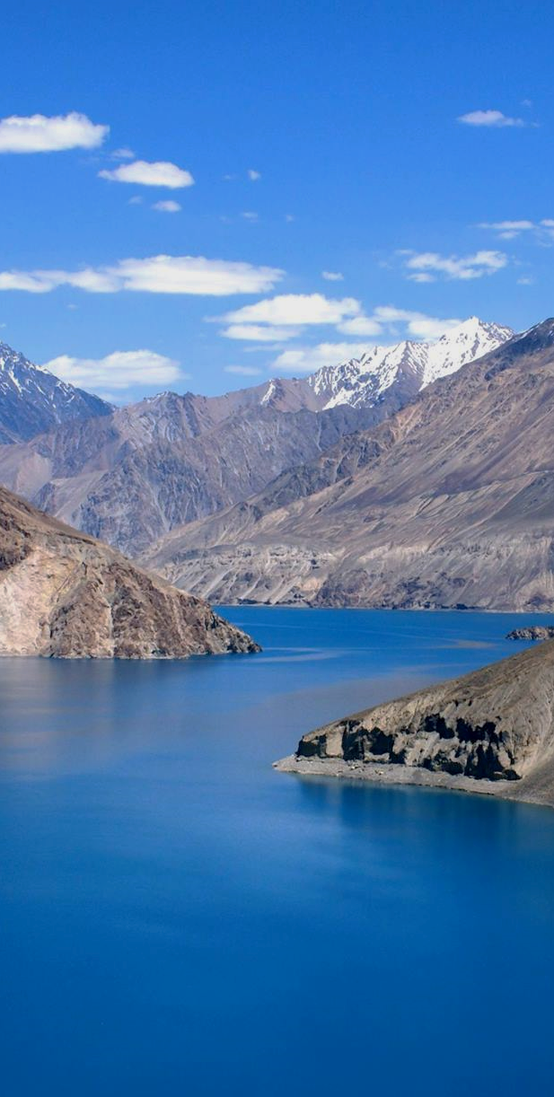
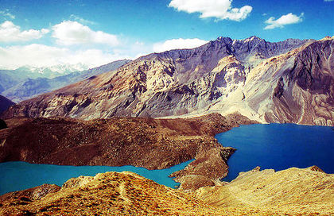
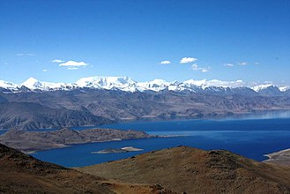
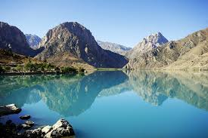
WATER RECOURSES
5 large glaciers
Abundance of underground water sources
.fresh .mineral .healing .thermal
1300 lakes
Length of rivers 28500 km.
68%
Of all fresh water recourses in Central Asia
Sarez 17 km³
Karakul 27 km³
Iskanderkul 3,4 km³

Slide 13
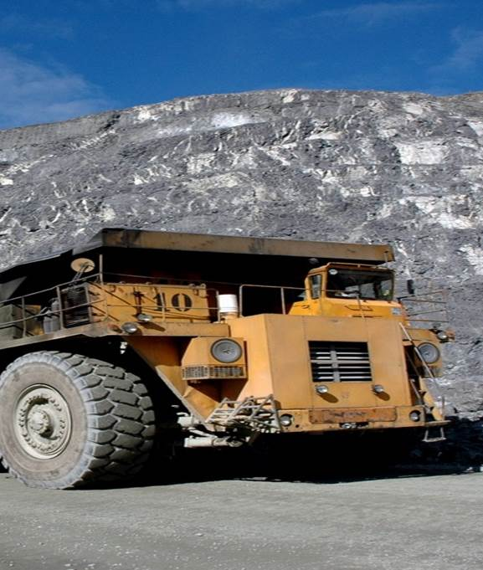
MINING
  The volume of proven silver reserves is 60 thousand tons, being the second largest in the world
  28 explored gold deposits with a deposit volume of more than 400 tons
  36 explored coal deposits, whose reserves are estimated at 5 billion tons
  Expected oil reserves - more than 7.9 mln tons, gas - 5.6 billion cubic meters
5 billion tons
coal reserves
60,000 tons
silver reserves
400
tons
gold
reserves

Slide 14
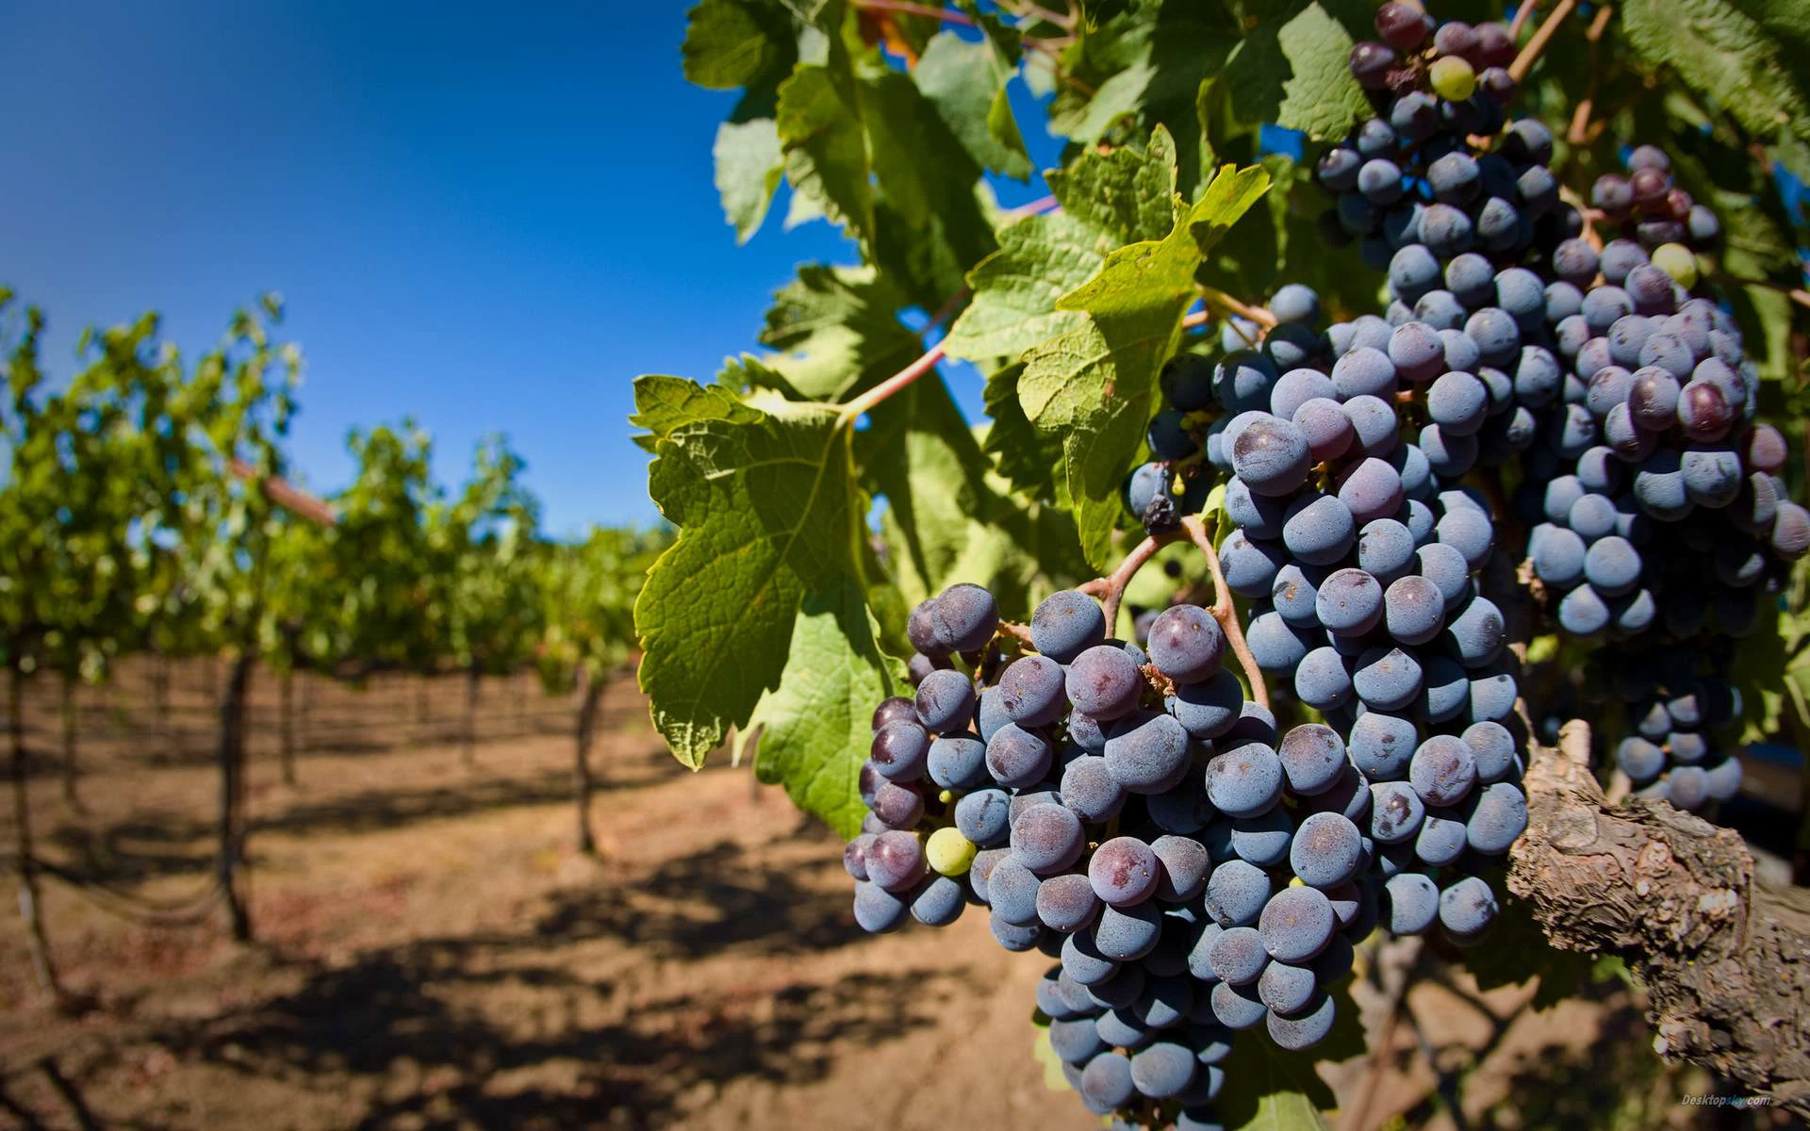

AGRICULTURE
70%
Of all jobs in the country
25%
Of countries export
35%
Of countries tax income
  Cotton 350 000 tons
  Vegetables 1 748 276 tons
  Fruits 364,799 tons
  Grapes 214 776 tons
Harvest
Cotton
share in exports
90%
Livestock 2016
meat
233.000 t
milk
917.000 t
wool
7,300 t

Slide 15
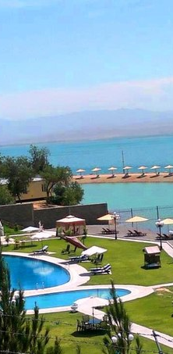

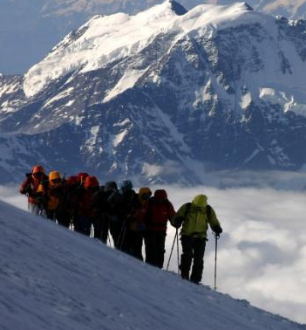
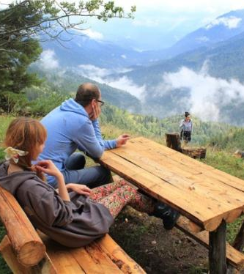
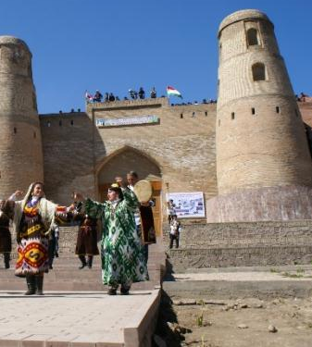
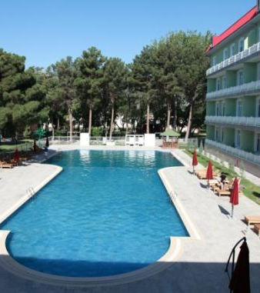
TOURISM
  Electronic Visa System
  3 international airports and 2 national airlines
  3 international five-star hotels
  158 hotels, 67 resorts
  86 sources of medicinal mineral waters
  Privileges for investors: The import of materials and equipment for the construction of tourist facilities is exempt from VAT and customs duties
(2016)
Mountain and Sport Tourism
Eco-Tourism
Historical and Cultural Tourism
  Medical tourism

Slide 16
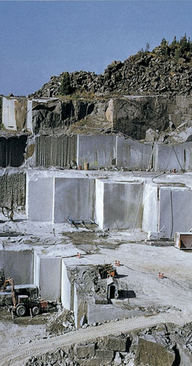
CONSTRUCTION MATERIALS
Extraction and processing of natural stone
Cement Production
Production of marble tiles
Production of basalt fiber

Slide 17
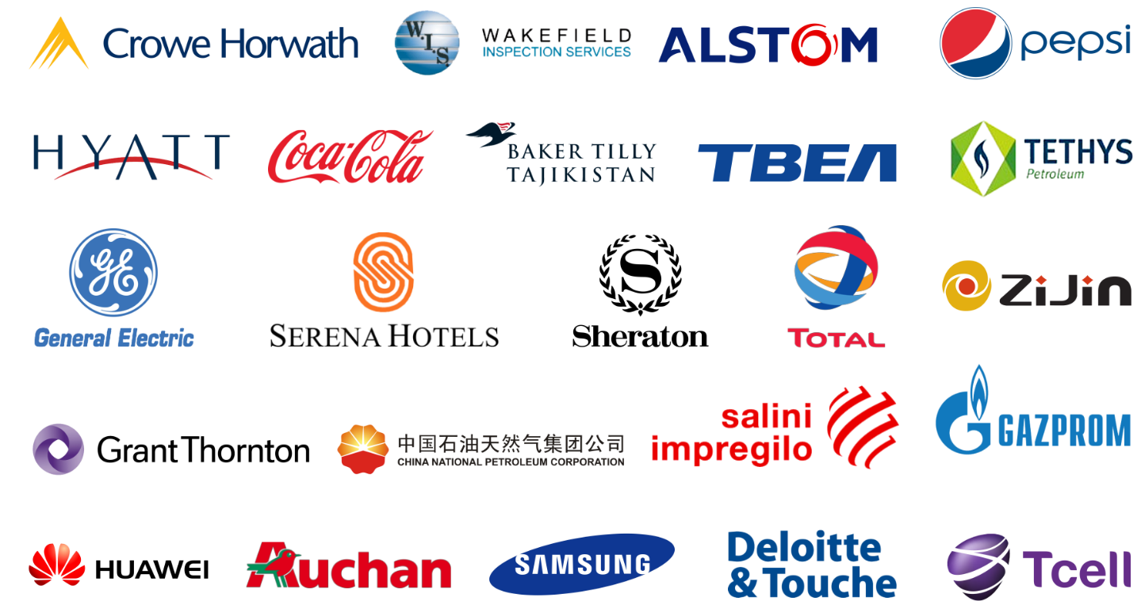


international companies in Tajikistan

Slide 18

TAJIKISTAN IN TE WORLD RATINGS
In the list of Top 10 reformers in the World Bank's Doing Business ranking for 2010, 2011, 2015,
The pace of poverty reduction in Tajikistan over the past 15 years is among the top 10 in the world. (from 83% to 31%)
4th place among the safest countries in the world in 2015 by the rating of the American Institute of Public Opinion Gallup.
6th place in the world for the use of "green energy" (99.56% of electricity) according to the World Bank report.
4 place in the ranking of countries with a simplified visa procedure, according to the British magazine Wanderlust travel.
In the list of Top 10 most attractive tourist destinations in 2014 ("Globe Spots").

Slide 19


CONTACTS
STATE COMMITTEE ON INVESTMENT AND STATE PROPERTY MANAGEMENT OF THE REPUBLIC OF TAJIKISTAN
  www.investcom.tj
  +992 37 221 86 59
  +992 37 221 57 29
  info@investcom.tj

