Slide 1
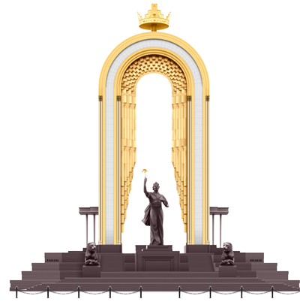
Republic of Tajikistan
Investment Opportunities and
Directions of Cooperation

Slide 2
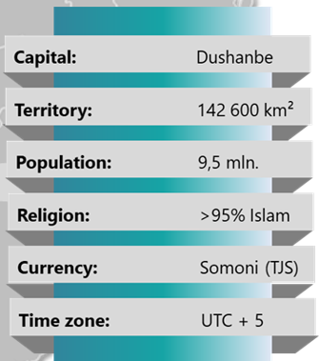
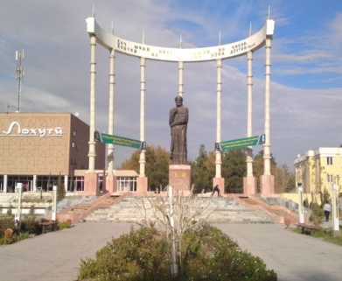
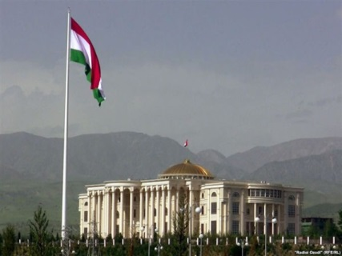
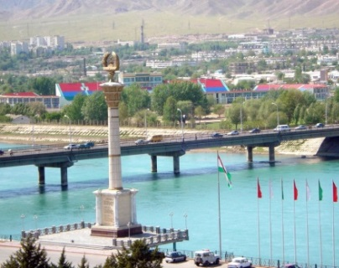
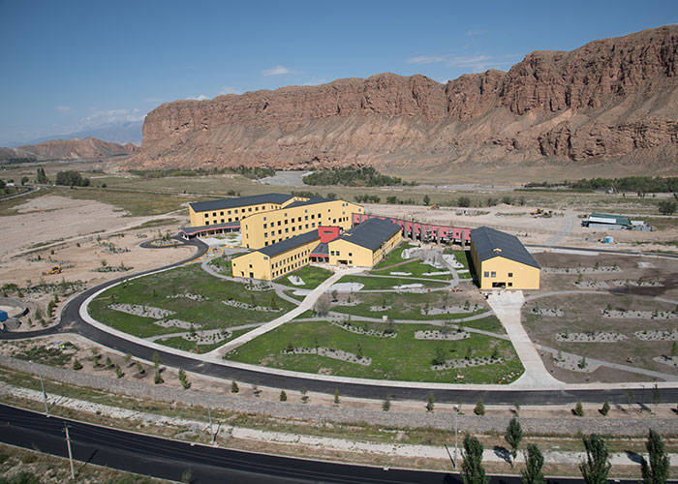
State Committee on
Investment and State
Property Management
of the Republic of Tajikistan
Republic of Tajikistan
A
Dushanbe
Khorog
Bohtar
Khujand

Slide 3
Macroeconomics
Sectors of Economy
Growth

Slide 4
FDI Dynamics
(mln US$)

Slide 5
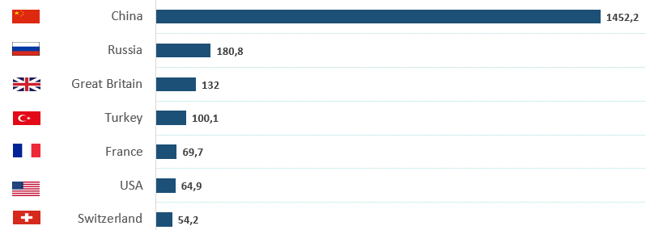
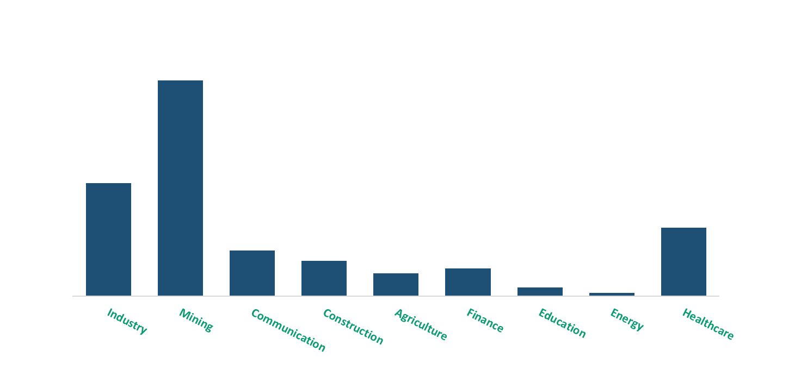
FDI by Countries and Sectors
By Countries
2015-2021
(proportional relationship)
By Sectors
2015-2021 (proportional relationship)

Slide 6
Foreign Trade in 2021
4,21 bln $
6,36 bln $
2,15 bln $

Slide 7
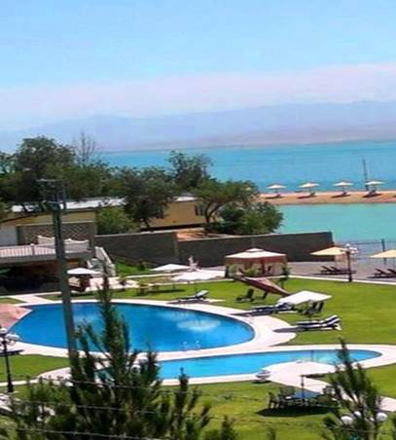
Priority Sectors
Renewable Energy
IT Sector/ High-tech
Tourism
Mining
Agriculture

Slide 8
Green Energy
Renewable Sources
(million tons of fuel equivalent)
Resources | Gross potential | Technical potential | Economic potential
Hydropower, general | 179,2 | 107,4 | 107,4
Including small hydropower plants | 62,7 | 20,3 | 20,3
Solar energy | 4 790,6 | 3,92 | 1,49
Biomass energy | 4,25 | 4,25 | 1,12
Wind power | 16,3 | 10,12 | 5,06
Geothermal energy | 0,04 | 0,04 | 0,04
Total (without large hydropower plants) | 5 020,595 | 38,63 | 27,95
Notes:
Таджикистан обладает достаточно большими запасами энергоресурсов. Особое место в этом контексте занимает гидроэнергоресурсы с потенциальными возможностями выработки 527 млрд. кВт. час\год.
Таджикистан занимает по этому показателю 8-ое место в мире и первое по гидроэнергетическому потенциалу на единицу территории страны.
Также в Таджикистане особое внимания уделяется вопросом по освоению возобновляемых энергии в том числе малой энергетики.
Известно, что в Республике Таджикистан преобладает ресурсы солнце, малых и средних. Так как, в стране более 200 дней с высокой интенсивностью солнечного сияния и множественное количество сточных рек.
В тоже время, рассматривается вопросы по освоению других видов ВИЭ, такие как энергия ветра, биомасса и геотермальная энергия.

Slide 9
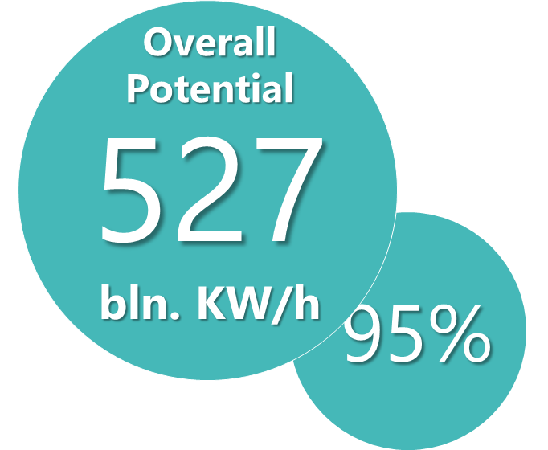
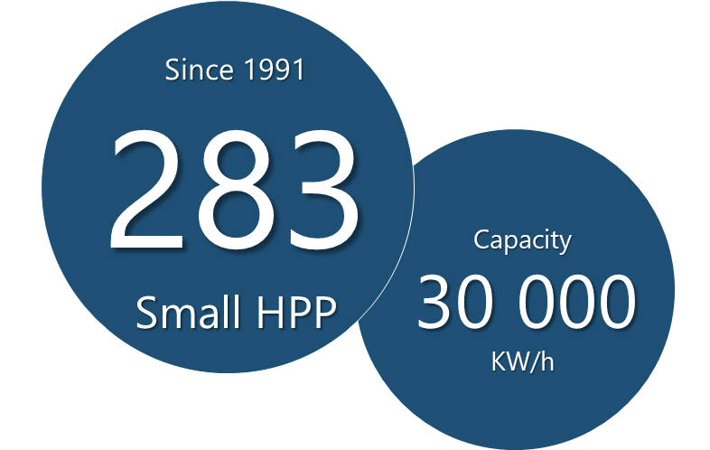
Hydropower
Market
The total potential is 527 billion kWh, 95% of this potential is awaiting development and investment
Since independence, 283 small hydropower plants have been commissioned with a total capacity of over 30,000 kW
Plan
Construction of small hydropower plants
Investment projects for the construction of high-voltage power lines
Repair of existing hydroelectric power plants (on Nurek 3.000 MW)
Construction of new large hydroelectric power plants (e.g. Rogun 3.600 MW)
Using other renewable sources (wind, solar)

Slide 10
Mining
5 billion tons
coal reserves
60,000 tons
silver reserves
400 tons
Gold
reserves
The volume of proven silver reserves is 60 thousand tons, being the second largest in the world
28 explored gold deposits with a deposit volume of more than 400 tons
36 explored coal deposits, whose reserves are estimated at 5 billion tons
Expected oil reserves - more than 7.9 mln tons, gas - 5.6 billion cubic meters

Slide 11
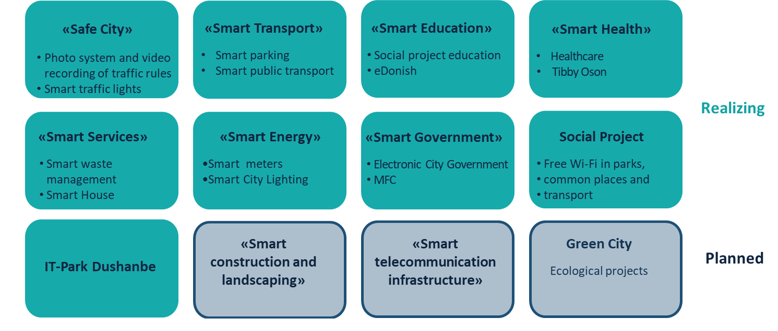
High Tech and IT
Projects “Smart City Dushanbe”
Проекты, которые находятся в стадии реализации
Проекты, которые планируются в будущем

Slide 12
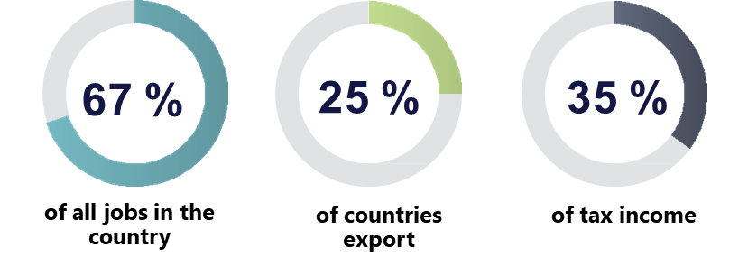
Agriculture
Target:
A significant increase in the share of processing cotton and other agricultural products within the country
Expansion of production capacity in the field of textile and knitted products
Construction of fruit and vegetable storage facilities
Infrastructure development, including further mechanization
Production of agricultural machinery and processing facilities

Slide 13
Medicinal Herbs
4 000
More than species of medicinal herbs
Pharmaceuticals
Cosmetology
The pharmaceutical market volume is approx. USD 150 million
More than 30 domestic manufacturers
97% of medicines are imported
13.0% increase in prices for pharmaceutical products in 2019
Mainly from the high mountain regions
Unique, environmentally friendly plants:
liquorice root
lavender
mountain plants
Target: Processing of medicinal herbs for the production of medicines, food supplements, tea, cosmetics, etc.
Incentives: The import of medicines, medical, pharmaceutical equipment and medical instruments is exempt from value added tax.
.

Slide 14
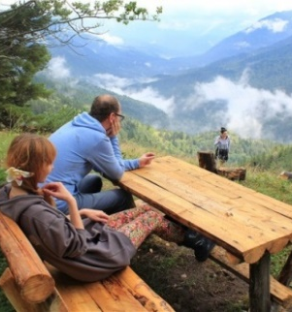
Tourism
Electronic Visa System
From 01.01.2022 visa-free regime for citizens of 52 countries;
4 international airports and 2 national airlines
3 international five-star hotels
158 hotels, 67 resorts
Mountain and Sport Tourism
Eco -Tourism
Historical and Cultural Tourism
Medical
Tourism

Slide 15
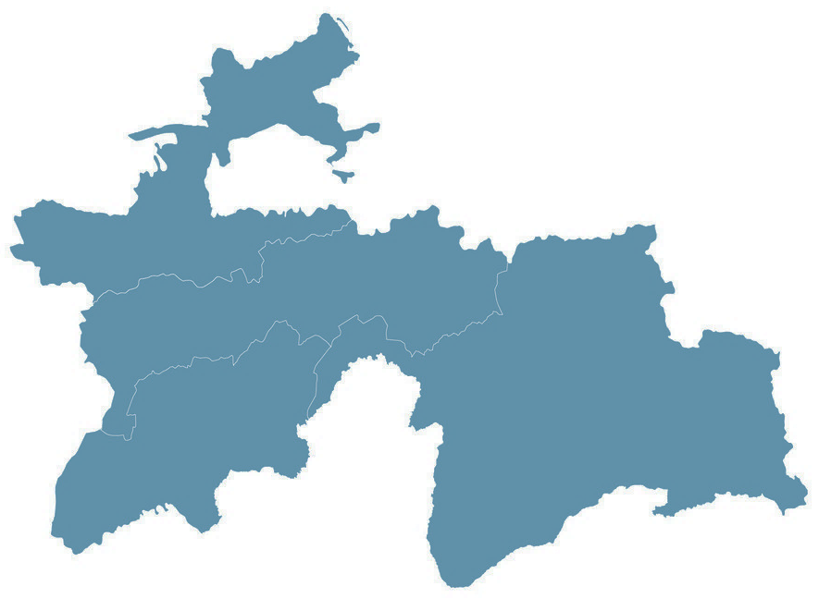
Doing Business

Slide 16
Incentives
Exemption from profit tax
Investments of more than five million dollars
for a term of 5 years
Investments from 2 to 4 million dollars
for a term of 4 years
Investments from 500 thousand to 2 million dollars for a term of 3 years
Investments from 200 thousand to 500 thousand dollars for a term of 2 years
Industry
The enterprises engaged in the full cycle of processing cotton fiber into the final product are exempted from profit tax and real estate tax for the period of 12 years.
Supply of precious metals and stones, jewelry, primary aluminum, cocoons, cotton fiber, cotton yarn and raw cotton is exempted from value added tax.
Tourism
Newly established enterprises operating in the sphere
of tourism are exempted from profit tax for a period of 5 years.
Importation of equipment and building materials for tourist sites is exempted from payment of value added tax and customs duties.
Securities market
Agriculture
Activity of the professional players of the securities market is exempted from payment of profit tax for a period of 5 years.
The investors, who are earning income from circulation of securities on the Stock Exchange of Tajikistan, are exempted from payment of income tax and dividend tax for a period of 5 years.
The importation of agricultural machinery is exempted from the payment of value added tax and custom duties.
Poultry farms and enterprises producing feed for poultry and cattle are exempted from profit tax, value added tax, real estate tax and motor road users tax for the period of 12 years.

Slide 17
Free Economic Zones
Sugd
2009
25 years
320 ha
23
Custom incentives
Developed infrastructure
Dangara
2011
25 years
521 га
26
Tax incentives
Single window
0%
Profit tax, property, transport, VAT and excise tax
Panj
2009
25 years
400 га
12
2019
25 years
309 га
1
2011
25 years
200 га
3
Kulob
Ishkashim

Slide 18
Investment Protection
39
Mutual promotion and protection of investments
Algeria, Armenia, Austria, Azerbaijan, Belarus, Belgium; BLEU (Belgium-Luxembourg Economic Union), China, Czech Republic, France, Germany, India, Indonesia, Iran, Kazakhstan, Kuwait, Kyrgyzstan, Lithuania, Luxembourg, Moldova, Mongolia, Netherlands, Pakistan, Republic of Korea. Slovakia, Spain, Switzerland, Syria , Turkmenistan, Ukraine, United Arab Emirates, Uzbekistan, Vietnam
7
Eurasian Investment Agreement
ECO Investment Agreement
EU-Tajikistan Partnership Agreement
USA-Central Asia TIFA
Convention on Investor Rights in CIS
Energy Charter Treaty
OIC Investment Agreement
Multilateral protection
of investments
35
Kyrgyzstan, Kazakhstan, Russia, Belarus, Armenia, Azerbaijan, Ukraine, Poland, Moldova, Czech Republic, Turkey, Iran, Germany, Indonesia, Pakistan, United Kingdom, Kuwait, Malaysia, Qatar, Austria, Thailand, Saudi Arabia, United Arab Emirates, Vietnam, Republic of Korea, Romania, Bahrain, Finland, Switzerland, Uzbekistan
Avoidance of double taxation

Slide 19
Investment Cooperation
Investment agreement
Production sharing agreement
Types
Concession agreement
Public private partnership

Slide 20
International Companies
TRANS TAJIK GAS PIPELINE

Slide 21
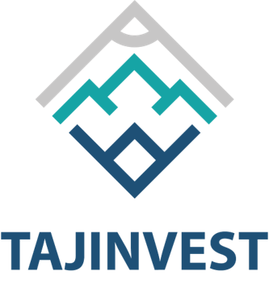
SUE «Tajinvest»
Tajikistan
State Unitary Enterprise
“Tajinvest”
info@tajinvest.tj
www.tajinvest.tj

Slide 22
b2b.tj - Business Portal Tajikistan
Source of information
Doing Business
Investment Opportunities
Find partners
Database
Sources of financing
Investment projects
Legislative documents
Support
Legal Issues
Tax advice
All questions regarding the business in Tajikistan
Capacity building of local entrepreneurs
www.b2b.tj
www.businessportal.tj

Slide 23
STATE COMMITTEE ON INVESTMENT AND STATE PROPERTY MANAGEMENT
OF THE REPUBLIC OF TAJIKISTAN
TAJINVEST
LET‘S GROW TOGETHER!

Slide 24
Thank you for your attention!
State Committee on Investment and State Property Management of the Republic of Tajikistan info@investcom.tj
www.investcom.tj
State Unitary Enterprise
“Tajinvest”
info@tajinvest.tj
www.tajinvest.tj

Slide 25
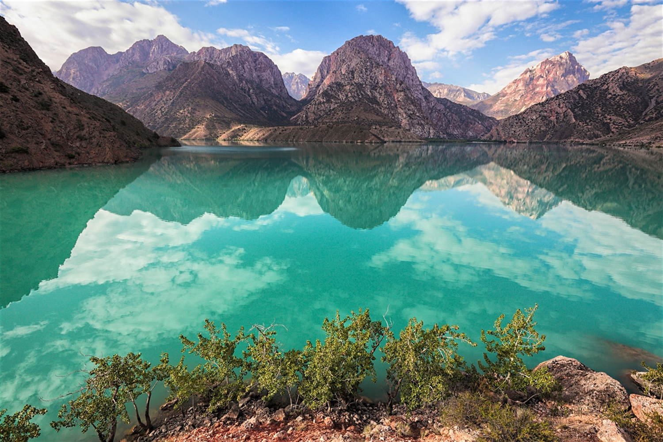
Welcome to Tajikistan

